Slide 1
ART OF PRESENTATION 3 PREPARING OF TIPS
Jaroslaw Makal
Bialystok University of Technology
Presentation is prepared in the frame of ICT_EDUPAND Project 2020-1-PL01-KA226-HE-096196
financed by ERASMUS+ Programme

Slide 2
MAY BE WITHOUT SLIDES?
Are you able to present the problem without any software like Power Point, Prezi, etc. (i.e. no pictures, movies, slides)?
https://www.ted.com/talks/

Slide 3
LEARN FROM MASTERS?
Use the library of TEDx Talks — local speakers presenting to local audiences about everything from politics to pollination.
https://www.ted.com/watch/tedx-talks
See and listen Ken Robinson
https://www.ted.com/talks/the_ted_interview_sir_ken_robinson_still_wants_an_education_revolution?language=en

Slide 4
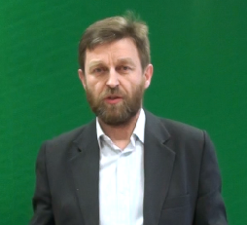
I HOPE YOU CAN PRESENT IN THIS WAY, TOO
This short (3 min.) presentation is in Polish however you can observe this movie as an example

Slide 5
RECORD YOURSELF - HOW WE CAN DO IT?
In the process of recruiting new employees, the company asks potential candidates to send a 1-minute video with the presentation of their image and information about themselves. Based on this data, invitations for interviews at the company's headquarters will be sent to selected candidates.

Slide 6
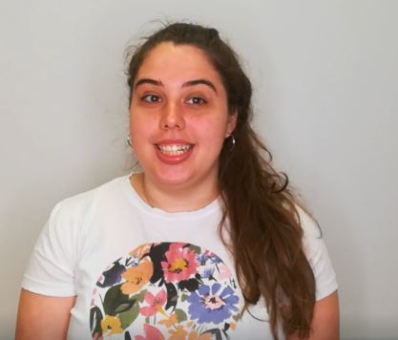
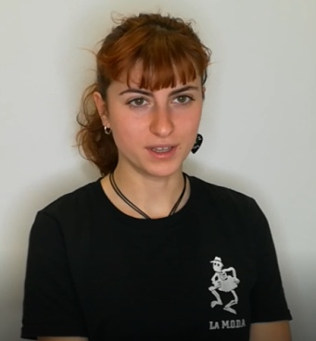
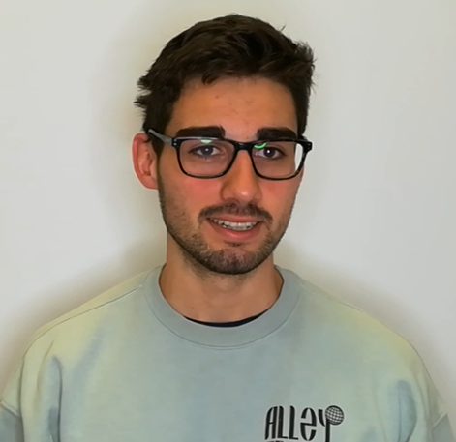
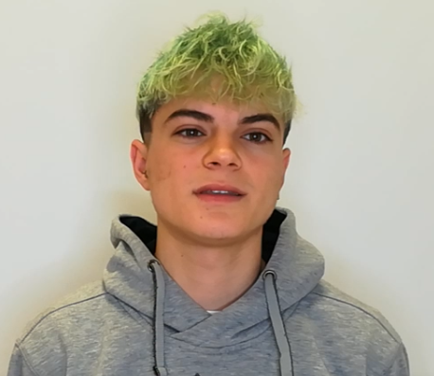
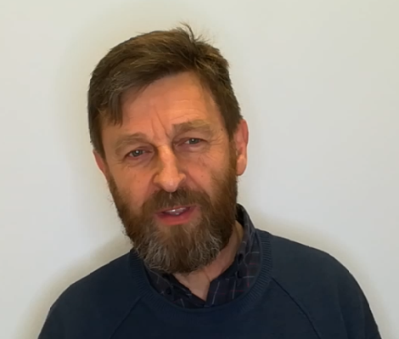
EXAMPLES

Slide 7
THE PRACTICE MAKES A MASTER
beginnings are always difficult;
start recording yourself;
write down everything you didn't like about your presentation;
try to improve at least some elements (not all at once);
re-record yourself;
if you managed to eliminate some of the flaws, then you have succeeded.

Slide 8
I WISH YOU SUCCESS
acting studies last 4.5 - 5 years;
the actor works on himself throughout his professional life;
Make each of your presentations better than the previous one
Jarosław Makal

