Slide 1
Communication in IoT systems based on the Bluetooth Low Energy standard Task 1 Grażyna Gilewska, PhD
ICT_EDUPAND Project 2020-1-PL01-KA226-HE-096196
Holistic approach towards problem-based ICT education based on international cooperation in pandemic conditions
Notes:
1

Slide 2
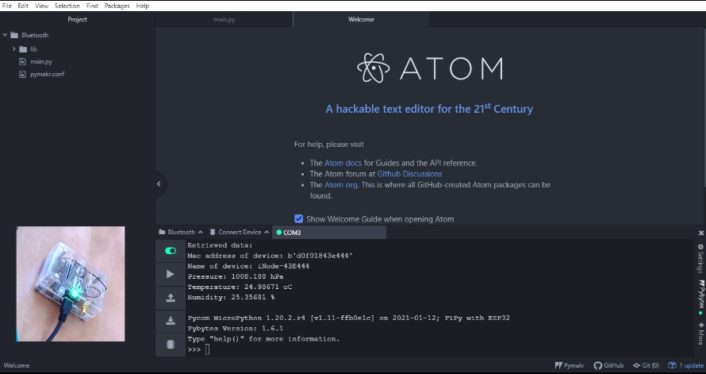
Task topic: Connect to a BLE Device and read data
Notes:
2

Slide 3
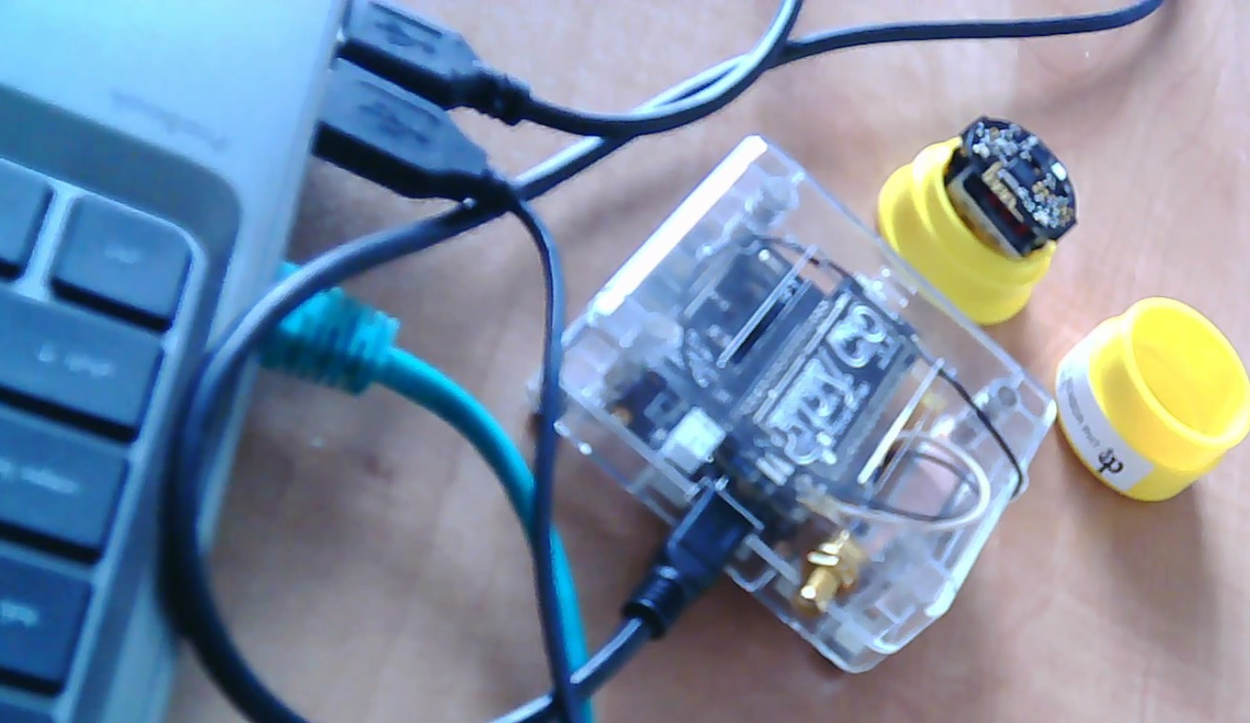
Devices used for task:
FiPy with ESP32 Pycom and Pysense expansion board
iNode Care Sensor PHT
Notes:
3

Slide 4
Use property constructors:
class network.Bluetooth
methods:
bluetooth.start_scan
bluetooth.get_adv()
bluetooth.resolve_adv_data
and commands:
ubinascii.hexlify
https://docs.pycom.io/firmwareapi/pycom/network/bluetooth/
Notes:
4

Slide 5
Realise the task in 3 parts:
Connecting to a device that is sending advertisements and receiving advertisement data
Connecting to the device sending advertisements and receiving device data
Connecting to the device sending advertisements and receiving measurement data
Notes:
5

Slide 6
Part 1
Scan until we can connect to any BLE device around:
from network import Bluetooth
import ubinascii
bth = Bluetooth() # create a Bluetooth object
bth.start_scan(-1) # start scanning with no timeout
while True:
adv = bth.get_adv()
if adv:
try:
bth.connect(adv.mac)
except:
# start scanning again
bth.start_scan(-1)
continue
break
adr_mac = ubinascii.hexlify(adv.mac) # convert hexadecimal to ascii
print('Mac address of device: ',adr_mac)
Notes:
6

Slide 7
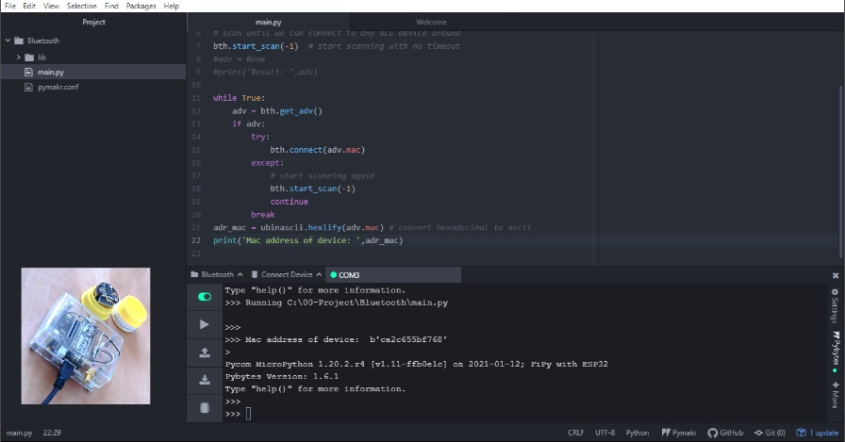
Part 1
Scan until we can connect to any BLE device around:
Notes:
7

Slide 8
Part 1
Scan until we can connect to any BLE device around:
We used the method:
bluetooth.get_adv()
gets tuple which has the following structure:
(mac, addr_type, adv_type, rssi, data)
mac - mac address of the device that sent the advertisement
addr_type - address type
adv_type - advertisement type received
rssi - signed integer with the signal strength of the advertisement
data - contains the complete 31 bytes of the advertisement message
Notes:
8

Slide 9
Part 1
Write a script for the task:
Using the method of:
bluetooth.get_adv()
read the following parameters of the BLE device we connected to:
mac , addr_type, adv_type, rssi
Constants:
Advertisement type: Bluetooth.CONN_ADV, Bluetooth.CONN_DIR_ADV, Bluetooth.DISC_ADV, Bluetooth.NON_CONN_ADV, Bluetooth.SCAN_RSP
Address type: Bluetooth.PUBLIC_ADDR, Bluetooth.RANDOM_ADDR, Bluetooth.PUBLIC_RPA_ADDR, Bluetooth.RANDOM_RPA_ADDR
https://docs.pycom.io/firmwareapi/pycom/network/bluetooth/
Notes:
9

Slide 10
Part 2
Connect to BLE device and get requested data type:
from network import Bluetooth
import time
import pycom
import ubinascii
bth = Bluetooth() # create a Bluetooth object
bth.start_scan(-1) # start scanning with no timeout
while True:
adv = bth.get_adv()
if adv:
try:
bth.connect(adv.mac)
except:
# start scanning again
bth.start_scan(-1)
continue
break
adr_manuf = bth.resolve_adv_data(adv.data, bth.ADV_NAME_CMPL)
print('\nName of device: ' + str(adr_manuf) + '\n')
pycom.heartbeat(False)
time.sleep(1)
pycom.rgbled(0xFF0000) # Red
Notes:
10

Slide 11
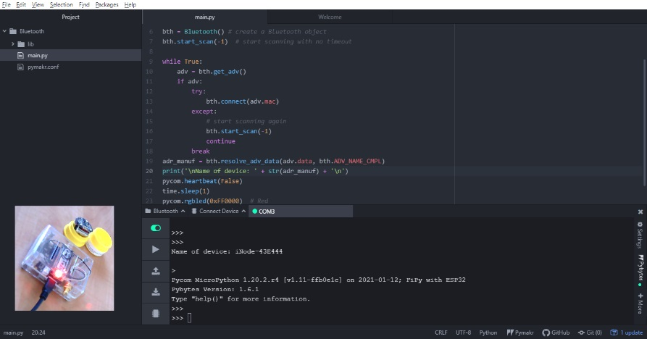
Part 2
Connect to BLE device and get requested data type:
Notes:
11

Slide 12
Part 2
Connect to BLE device and get requested data type:
We used the method:
bluetooth.resolve_adv_data(data, data_type)
returns the requested data_type if present
data - bytes object with the complete advertisement data
data_type - data type to resolve from from the advertisement data.
Notes:
12

Slide 13
Part 2
Write a script for the task:
Using the method of:
bluetooth.resolve_adv_data(data, data_type)
read the following parameters of the BLE device we connected to:
flag, short name, manufacturer data
Constants:
Advertisement data type: Bluetooth.ADV_FLAG, Bluetooth.ADV_16SRV_PART, Bluetooth.ADV_T16SRV_CMPL, Bluetooth.ADV_32SRV_PART, Bluetooth.ADV_32SRV_CMPL, Bluetooth.ADV_128SRV_PART, Bluetooth.ADV_128SRV_CMPL, Bluetooth.ADV_NAME_SHORT, Bluetooth.ADV_NAME_CMPL, Bluetooth.ADV_TX_PWR, Bluetooth.ADV_DEV_CLASS, Bluetooth.ADV_SERVICE_DATA, Bluetooth.ADV_APPEARANCE, Bluetooth.ADV_ADV_INT, Bluetooth.ADV_32SERVICE_DATA, Bluetooth.ADV_128SERVICE_DATA, Bluetooth.ADV_MANUFACTURER_DATA
https://docs.pycom.io/firmwareapi/pycom/network/bluetooth/
Notes:
13

Slide 14
Part 3
Connect to BLE device with known MAC number and receive measurement data:
from network import Bluetooth
import ubinascii
import struct
import pycom
import time
bt = Bluetooth()
bt.start_scan(10) # starts scanning and stop after 10 seconds
pycom.heartbeat(False)
pycom.rgbled(0xFF0000) # Red
while bt.isscanning():
adv = bt.get_adv()
if adv and ubinascii.hexlify(adv.mac) == b'd0f01843e444':
time.sleep(1)
pycom.rgbled(0x0000FF) # Blue
print('\nRetrieved data:')
adv_manuf = bt.resolve_adv_data(adv.data, bt.ADV_NAME_CMPL)
print('\nName of device: ' + str(adv_manuf))
data_manuf = ubinascii.hexlify(bt.resolve_adv_data(adv.data, bt.ADV_MANUFACTURER_DATA))
press=data_manuf[12:16]
press2 = ubinascii.unhexlify(press)
press3=(struct.unpack("<H",press2)[0])/16
print('\nPressure: ' + str(press3) + ' hPa\n')
pycom.rgbled(0x00FF00) # Green
Notes:
14

Slide 15
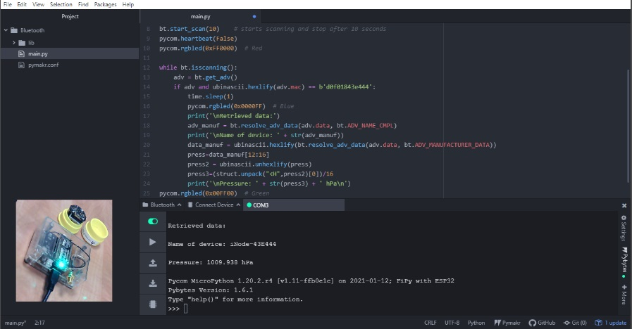
Part 3
Connect to BLE device with known MAC number and receive measurement data:
Notes:
15

Slide 16
Part 3
Connect to BLE device with known MAC number and receive measurement data:
We used iNode Manufacturer Specific Data:
iNode Care Sensor PHT (0x9D)
12 9D 01 C0 00 00 4F 3E 3F 19 95 12 03 00 3C C0 91 99 BB A2 CC 23 AC 82
12 | bit 2: rtto bit 3: lowBattery
9D | iNode Care Sensor PHT
01 c0 | groupsAndBattery (uint16le);
00 00 | Alarms (uint16le);
4f 3e | rawPressure (uint16le);
3f 19 | rawTemperature (uint16le);
95 12 | rawHumidity (uint16le);
03 00 | rawTime1 (uint16le);
3c c0 | rawTime2 (uint16le)
91 99 bb a2 cc 23 ac 82 | AES128 digital signature for the above data
https://inode.pl
Notes:
16

Slide 17
Part 3
Write a script for the task:
Using iNode Manufacturer Specific Data iNode Care Sensor PHT
converting hexadecimal to ascii by ubinascii
decoding Little endian by struct
Calculation of humidity (H[%]):
H = (125 * rawHumidity * 4 / 65536) – 6
Calculation of temperature (T[°C]):
T = (175.72 * rawTemperature * 4 / 65536) - 46.85
Connect to BLE device with known name: iNode-43E444
and read the following parameters of the BLE device we connected to:
Temperature, Humidity
https://inode.pl
Notes:
17

